Slide 1


Slide 2


why careconnect ?

Slide 3


what should I do?
Problem Statement
Inefficient access to accurate emergency information
Fragmented Healthcare Information:Poor management of vaccination schedules, medical records, and follow-up care
Lack of Timely Medical Assistance:Difficulty in accessing immediate health advice and resources
Inadequate Pregnancy Monitoring:lack accessible tools to track crucial milestones risking complications

Slide 4

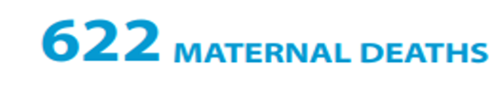
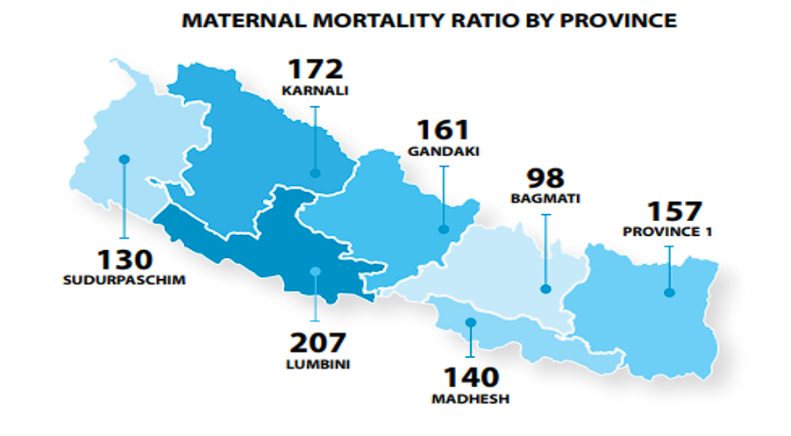
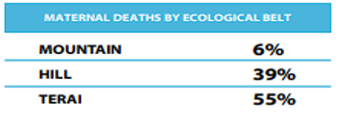

Slide 5
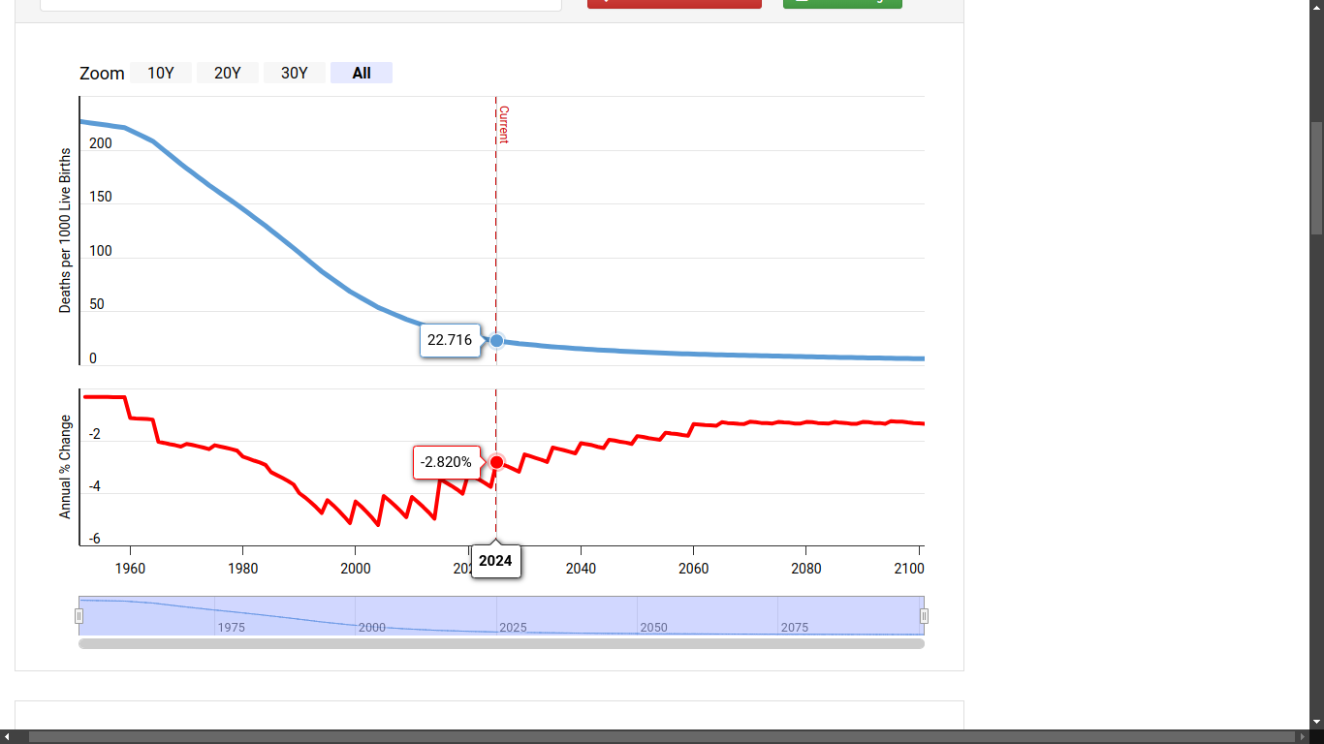
The current infant mortality rate for Nepal in 2024 is 22.716 deaths per 1000 live births

Slide 6


Use careconnect
The Solution- Careconnect
“A comprehensive platform to simplify healthcare management for families in Nepal”
Key Features:
Vaccination Tracker.
Pregnancy Care Management
SMS Services for Timely Vaccination Remainder
Simple and interactive UI

Slide 7

Social Impact
Improve maternal and child healthcare outcomes
Reduced Healthcare Burden
Support for National Health Goals
Affordable and Scalable Solution

Slide 8

Plans for the Future
AI-Powered Health Assistant
Real-Time Disease Surveillance
Mental Health Resources
Health Tracking & Alerts

Slide 9

Business Model (CareConnect)
Revenue Generation : Partnerships with health organizations, and potential funding from NGOs or government.
Target Audience: Rural individuals, healthcare providers in remote areas
Value Proposition: Offering accessible, SMS-based healthcare, health tracking
Customer Acquisition: Community outreach programs, partnerships with local clinics and Hospitals.

Slide 10
Conclusion:
Together, we can make healthcare smarter, accessible, and impactful.

Slide 11


